Slide 1


Welcome to our class
Teacher: Mrs Ly

Slide 2
Warm up.
Networks
Vietnamese
Subjects

Slide 3
Textbook
Page: 40

Slide 4




School timetable
* Vocabulary
 | Mon. | Tues. | Wed. | Thurs. | Fri.
Music
√
once a week
Science
√
√
twice a week
Vietnamese
√
√
√
√
four times a week
Maths
√
√
√
√
√
every school day
1. How many lessons do you have on Tuesday ?
2. How often do you have Vietnamese?

Slide 5
Sentences:
Ask and answer questions about the school timetable.
How many lessons do you have__________ ?
I have__________
today
Monday
How often do you have _________?
I have it __________
English
Maths

Slide 6
2.Point and say.
 | Mon. | Tues. | Wed. | Thurs. | Fri.
Maths |  |  |  |  | 
IT | 
Science |  |  |  | 
Art |  |  |  | 
Music |  |  | 
Vietnamese |  |  |  |  | 
PE |  |  | 
English |  |  |  |  | 
How many lessons do you have today ?
I have_______________________

Slide 7
Let’s listen!!!
P.41

Slide 8





Game

Slide 9


Lucky numbers
2
3
1
4
6
5

Slide 10




Lucky number !

Slide 11




How many lessons do you have today?
I have _________________________________
four: Maths, English, Music and Science.

Slide 12


How many lessons do you have today?
I have _______________________________
three: Maths, English and Vietnamese.

Slide 13
How often do you have Science?
I have it____________________
twice a week
 | Mon. | Tues. | Wed. | Thurs. | Fri.
Maths |  |  |  |  | 
IT | 
Science |  |  |  | 
Art |  |  |  | 
Music |  |  | 
Vietnamese |  |  |  |  | 
PE |  |  | 
English |  |  |  |  | 

Slide 14


Homework
Learn by heart the sentence pattern.
Practice the sentence at home
Prepare next lesson Unit 6: lesson 2

Slide 15
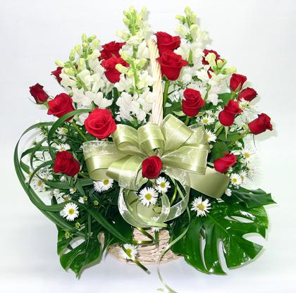
Thanks for your attendance.
Good bye!

